Slide 1
Exercise - Learning Objectives
By the end of this exercise you will be able to:
Define Solar PV technology generating electricity at the decentralized level, along with a temporal profile of generation
Define Solar PV technology, coupled with a battery, generating electricity at the decentralized level, along with an assumed temporal profile of generation
Run the model and check results on production by technology and capacity of each technology

Slide 2
Demand for future connections
Natural Gas
Electricity
Demand for electrified population
Natural Gas Production
Hydro run-of-river
Transmission & Distribution
Hydro Dam
Grid Expansion
Natural Gas Imports
Wind
Dist. Solar PV
New CCGT/GT
Dist. Solar PV with battery
Backstop 1
Backstop 2

Slide 3
Demand for future connections
Natural Gas
Electricity
Demand for electrified population
Natural Gas Production
Hydro run-of-river
Transmission & Distribution
Hydro Dam
Grid Expansion
Natural Gas Imports
Wind
Dist. Solar PV
New CCGT/GT
Dist. Solar PV with battery
Backstop 1
Backstop 2

Slide 4
Defining a solar technology
We continue to create a TECHNOLOGY called SOLPV1 (i.e. solar PV rooftop).
The following parameters are taken into account
OutputActivityRatio: defines the rate of fuel provided (i.e. Electricity)
VariableCost: defines the variable Operation & Maintenance cost ($M/PJ or $/GJ)
CapitalCost: defines the overnight investment cost of the plant ($M/GW or $/kW)
CapacityFactor: represents the variability in generation at each point in time.
OperationalLife: defines the lifetime of the technology (in years)
CapacitytoActivityUnit: defines how much activity can occur by one unit of capacity in one year (in this case we are using GW for capacity and PJ for energy, thus 1 GW can provide 31.536 PJ annually)

Slide 5
Defining a solar technology
For the SOLPV1 technology, let’s define the following.
OutputActivityRatio: Choose the FEL2 fuel and insert the following for mode of operation 1.
Note that for RET, we don’t need to define an input fuel
Mode | 2014 | 2015 | 2016 | 2017 | 2018 | 2019 | 2020 | 2021 | 2022
1 | 1 | 1 | 1 | 1 | 1 | 1 | 1 | 1 | 1
 | 2023 | 2024 | 2025 | 2026 | 2027 | 2028 | 2029 | 2030 | 2031
1 | 1 | 1 | 1 | 1 | 1 | 1 | 1 | 1 | 1
 | 2032 | 2033 | 2034 | 2035 | 2036 | 2037 | 2038 | 2039 | 2040
1 | 1 | 1 | 1 | 1 | 1 | 1 | 1 | 1 | 1

Slide 6
Defining a solar technology
For the SOLPV1 technology, let’s define the following.
VariableCost: Insert the following for mode of operation 1.
Mode | 2014 | 2015 | 2016 | 2017 | 2018 | 2019 | 2020 | 2021 | 2022
1 | 2.5 | 2.5 | 2.5 | 2.5 | 2.5 | 2.5 | 2.5 | 2.5 | 2.5
 | 2023 | 2024 | 2025 | 2026 | 2027 | 2028 | 2029 | 2030 | 2031
1 | 2.5 | 2.5 | 2.5 | 2.5 | 2.5 | 2.5 | 2.5 | 2.5 | 2.5
 | 2032 | 2033 | 2034 | 2035 | 2036 | 2037 | 2038 | 2039 | 2040
1 | 2.5 | 2.5 | 2.5 | 2.5 | 2.5 | 2.5 | 2.5 | 2.5 | 2.5

Slide 7
Defining a solar technology
For the SOLPV1 technology, let’s define the following.
CapitalCost: Insert the following values.
The OperationalLife can be set to 25 years, while the CapacitytoActivityUnit can be set to 31.536.
 | 2014 | 2015 | 2016 | 2017 | 2018 | 2019 | 2020 | 2021 | 2022
SOLPV1 | 1700 | 1700 | 1700 | 1700 | 1700 | 1700 | 1600 | 1600 | 1600
 | 2023 | 2024 | 2025 | 2026 | 2027 | 2028 | 2029 | 2030 | 2031
SOLPV1 | 1600 | 1600 | 1500 | 1500 | 1500 | 1500 | 1500 | 1400 | 1400
 | 2032 | 2033 | 2034 | 2035 | 2036 | 2037 | 2038 | 2039 | 2040
SOLPV1 | 1400 | 1400 | 1400 | 1300 | 1300 | 1300 | 1300 | 1300 | 1200

Slide 8
Solar variability in generation

Slide 9
Solar variability in generation
For the SOLPV1 technology, let’s define the following.
CapacityFactor: Insert the following values for the entire modelling period.
ID | 0.3
IN | 0
SD | 0.4
SN | 0
WD | 0.25
WN | 0

Slide 10
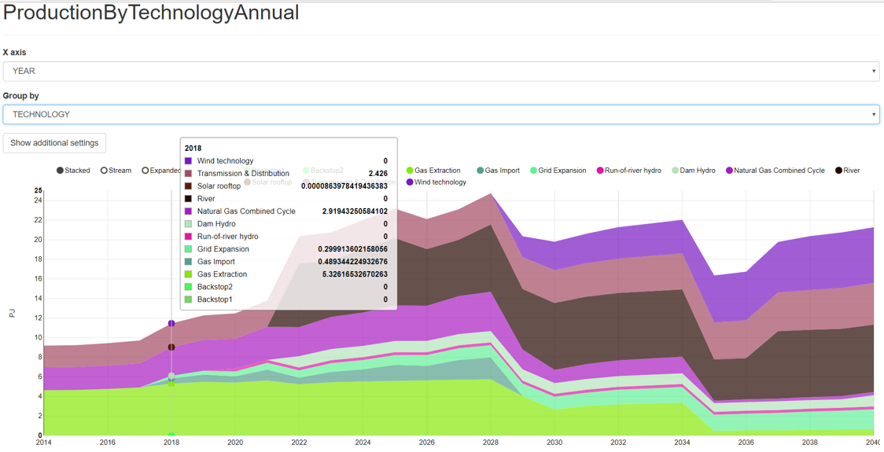
Run the model and check the results!

Slide 11
Defining a solar technology
We continue to create a TECHNOLOGY called SOLPV2 (i.e. solar PV rooftop with battery).
The following parameters are taken into account
OutputActivityRatio: defines the rate of fuel provided (i.e. Electricity)
VariableCost: defines the variable Operation & Maintenance cost ($M/PJ or $/GJ)
CapitalCost: defines the overnight investment cost of the plant ($M/GW or $/kW)
CapacityFactor: represents the variability in generation at each point in time.
OperationalLife: defines the lifetime of the technology (in years)
CapacitytoActivityUnit: defines how much activity can occur by one unit of capacity in one year (in this case we are using GW for capacity and PJ for energy, thus 1 GW can provide 31.536 PJ annually)

Slide 12
Defining a solar technology
For the SOLPV2 technology, let’s define the following.
OutputActivityRatio: Choose the FEL2 fuel and insert the following for mode of operation 1.
Note that for RET, we don’t need to define an input fuel
Mode | 2014 | 2015 | 2016 | 2017 | 2018 | 2019 | 2020 | 2021 | 2022
1 | 1 | 1 | 1 | 1 | 1 | 1 | 1 | 1 | 1
 | 2023 | 2024 | 2025 | 2026 | 2027 | 2028 | 2029 | 2030 | 2031
1 | 1 | 1 | 1 | 1 | 1 | 1 | 1 | 1 | 1
 | 2032 | 2033 | 2034 | 2035 | 2036 | 2037 | 2038 | 2039 | 2040
1 | 1 | 1 | 1 | 1 | 1 | 1 | 1 | 1 | 1

Slide 13
Defining a solar technology
For the SOLPV2 technology, let’s define the following.
VariableCost: Insert the following for mode of operation 1.
Mode | 2014 | 2015 | 2016 | 2017 | 2018 | 2019 | 2020 | 2021 | 2022
1 | 3.5 | 3.5 | 3.5 | 3.5 | 3.5 | 3.5 | 3.5 | 3.5 | 3.5
 | 2023 | 2024 | 2025 | 2026 | 2027 | 2028 | 2029 | 2030 | 2031
1 | 3.5 | 3.5 | 3.5 | 3.5 | 3.5 | 3.5 | 3.5 | 3.5 | 3.5
 | 2032 | 2033 | 2034 | 2035 | 2036 | 2037 | 2038 | 2039 | 2040
1 | 3.5 | 3.5 | 3.5 | 3.5 | 3.5 | 3.5 | 3.5 | 3.5 | 3.5

Slide 14
Defining a solar technology
For the SOLPV2 technology, let’s define the following.
CapitalCost: Insert the following values.
The OperationalLife can be set to 25 years, while the CapacitytoActivityUnit can be set to 31.536.
 | 2014 | 2015 | 2016 | 2017 | 2018 | 2019 | 2020 | 2021 | 2022
SOLPV2 | 2700 | 2700 | 2700 | 2700 | 2700 | 2700 | 2600 | 2600 | 2600
 | 2023 | 2024 | 2025 | 2026 | 2027 | 2028 | 2029 | 2030 | 2031
SOLPV2 | 2600 | 2600 | 2500 | 2500 | 2500 | 2500 | 2500 | 2400 | 2400
 | 2032 | 2033 | 2034 | 2035 | 2036 | 2037 | 2038 | 2039 | 2040
SOLPV2 | 2400 | 2400 | 2400 | 2300 | 2300 | 2300 | 2300 | 2300 | 2200

Slide 15
Defining a solar technology
For the SOLPV2 technology, let’s define the following.
CapacityFactor: Insert the following values for the entire modelling period.
Note that we assume a fixed profile for discharging of the battery (i.e. simplification)
ID | 0.25
IN | 0.12
SD | 0.3
SN | 0.15
WD | 0.2
WN | 0.1

Slide 16
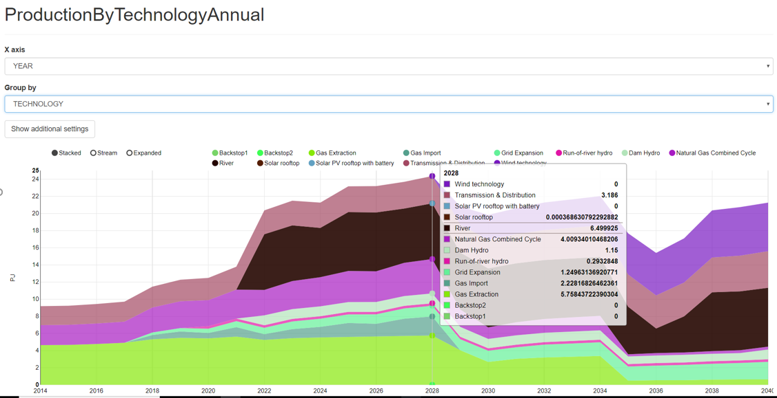
Run the model and check the results!

